Slide 1
Overview: Phases of Human Growth and Development
Dr. Imran A. Sajid

Slide 2
Stages of life in general
Childhood
Boyhood/Girlhood
Adulthood
Old-Age
بچہ
جوان
بوڑھا
نونہال
بچہ
نوجوان
جوان
بوڑھا

Slide 3
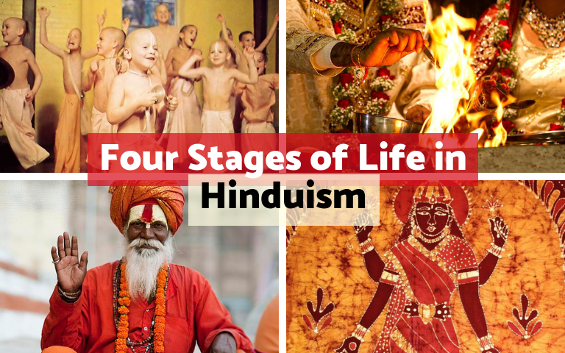
Stages of Life in Hindu text
Brahmacharya (student life, Till 24)
Grihastha (household life, 24-48)
Vanaprastha (retired life, 48-72)
Sannyasa (renounced life, 72+)
a student,
a householder,
a retiree
a religious ascetic.
Source: https://en.wikipedia.org/wiki/Ashrama_(stage)

Slide 4
Ashram or stage | Age (years) | Description
Brahmacharya (student life) | Till 24 | Brahmacharya represented the bachelor student stage of life. This stage focuses on education and included the practice of celibacy. The student went to a Gurukul (house of the guru) and typically would live with a Guru (teacher), acquiring knowledge of science, philosophy, scriptures and logic, practicing self-discipline, working to earn dakshina to be paid for the guru, learning to live a life of Dharma (righteousness, morals, duties).
Grihastha (household life) | 24–48 | This stage referred to the individual's married life, with the duties of maintaining a household, raising a family, educating one's children, and leading a family-centred and a dharmic social life. Grihastha stage was considered as the most important of all stages in sociological context, as human beings in this stage not only pursued a virtuous life, they produced food and wealth that sustained people in other stages of life, as well as the offsprings that continued mankind. The stage also represented one where the most intense physical, sexual, emotional, occupational, social and material attachments exist in a human being's life.
Vanaprastha (retired life) | 48–72 | The retirement stage, where a person handed over household responsibilities to the next generation, took an advisory role, and gradually withdrew from the world. Vanaprastha stage was a transition phase from a householder's life with its greater emphasis on Artha and Kama (wealth, security, pleasure and sexual pursuits) to one with greater emphasis on Moksha (spiritual liberation).
Sannyasa (renounced life) | 72+ (or anytime) | The stage was marked by renunciation of material desires and prejudices, represented by a state of disinterest and detachment from material life, generally without any meaningful property or home (Ascetic), and focused on Moksha, peace and simple spiritual life. Anyone could enter this stage after completing the Brahmacharya stage of life.

Slide 5
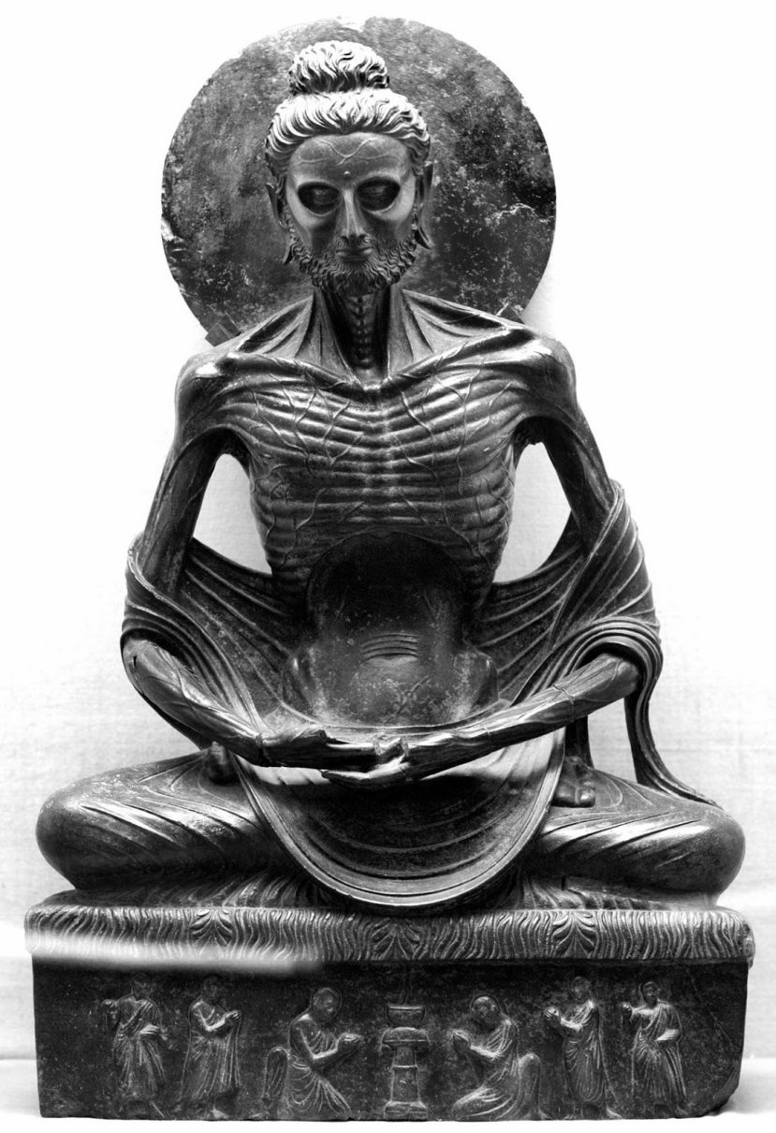
Stages of Life in Buddhism
Decade of
Tender
Sports
Beauty
Strength
Understanding
Decline
Stooping (bend body)
Bent (curved body)
Dotage (2nd childhood)
Prone (lying face down)
480 BCE
Source: Guide to Buddhism A to Z: https://www.buddhisma2z.com/content.php?id=229

Slide 6
Baby: `tender baby, vulnerable, lying on its back and playing with his own faeces'. He identified this as the individual's initial pleasurable experience, albeit a crude one which would eventually be grown out of.
Child: `that child grows older and with the awakening of his sense faculties plays with toy ploughs, tip-cat, jumping, leaf windmills, marbles, toy chariots and toy bows'. Such pleasurable games are, the Buddha said, at a higher level but will nonetheless eventually be outgrown also.
Adult: `having grown older, with the complete development of the sense faculties and experiencing the five sense pleasures, he comes under the sway of, gripped by, fascinated with and addicted to, objects seen with the eye, sounds heard with the ear, odours smelled with the nose, tastes tasted with the tongue and sensations felt with the body'.
Old-age: In the last stage the individual gives up sensual pursuits, embarks on the spiritual quest and attain peace and joy through meditation

Slide 7
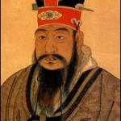
Confucius and Stages of Life
In The Analects (autobiography), Confucius (500 B.C.) provides us with one of the earliest maps of human development.
Source: https://www.institute4learning.com/2012/08/08/the-stages-of-life-according-to-confucius/

Slide 8
Confucius and life stages
At 15 , I set my mind on learning. (studying classics, to learn about the laws of the society and the universe.)
At 30, I stood firm. (established goal of life, and stood firm on it.)
At 40, I had no doubts. (about himself and the world.)
At 50, I knew the decrees of Heaven. (he was clear about what the universe had arranged for him, and could feel and align with by moment.)
At 60, no sound irritates me. (he was able to embrace the world without internally getting irritated.)
At 70, I could follow what my heart desired, without transgressing what was right. (with morality firmly established and practiced within himself, he was able to live life freely without committing wrong.)

Slide 9
Erik Erikson’s Eight Stages of Development
Infancy: Birth to 18 Months
the challenge of trust vs mistrust
Toddlerhood: up to age 3
the challenge of autonomy vs doubt and shame
Preschool: age 4 -5 years
the challenge of initiative vs guilt
Preadolescence: age 6-13
the challenge of industriousness vs inferiority
Adolescence: Teen years
the challenge of gaining identity vs confusion
Young adulthood:
the challenge of intimacy vs isolation
Middle adulthood:
the challenge of making a difference vs self-absorption
Old-age:
the challenge of integrity vs despair

Slide 10
Stages of Life in Modern Day Developmental Psychology
1. Pre-natal Development
Zygote
Embryo
Critical Period
Fetus
Age of Viability
2. Neonacy
Birth to 01 Month approx
3. Infancy
01 to 12 Months approx
4. Early Childhood
Toddler (01- 03 Y)
Pre-School Child (03-06Y)
5. Middle Childhood
School Child (06-12)
6. Late Childhood
Puberty (13+Y)

Slide 11
7. Adolescence (14m 12f to app 20)
Transition from childhood/puberty to Adulthood
8. Adulthood (app 20-60Y)
Early Adulthood (20 – 30)
Middle Adulthood (30-40)
Late Adulthood (40-60)
9. Old Age (60+Y)
Young Old (60-74)
Middle Old (75-84)
Old Old (85+)

